Slide 1
Data Curation Project
UEFA Champions League matches between 2016-2022
Diego Escondrillas & Syed Wali Uddin Quadri

Slide 2
Identified datasets
Dataset 1:
Multiple tables:
Matches
Season
Datetime
Home Team
Away Team
Home Score
Away Score
Players:
Name
Position
DOB
Jersey number
Goals
Name
Goal description
Dataset 2:
Matches:
Datetime
Team1
Team2
Score1
Score2

Slide 3
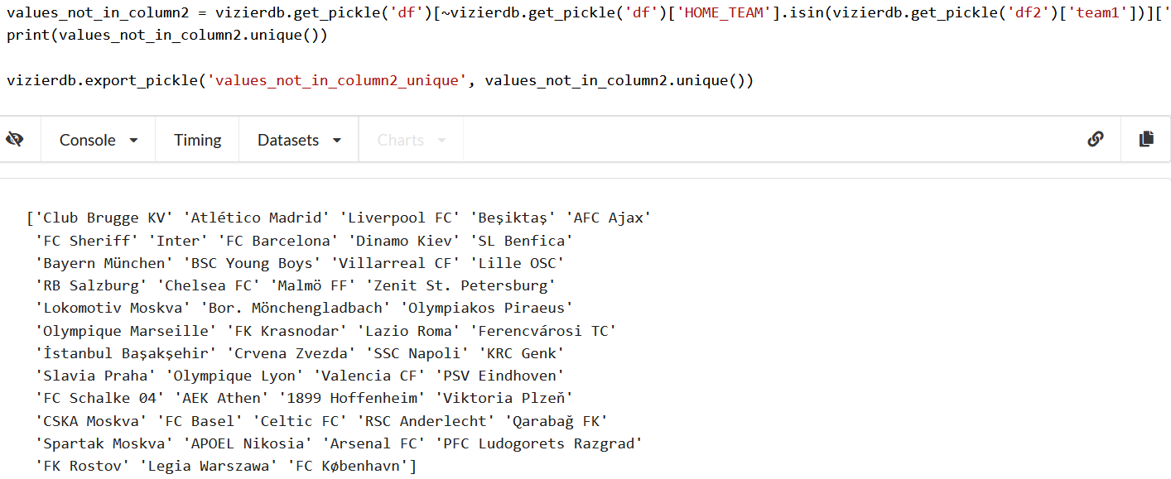
Issues
By looking at the “matches” tables:
5 schema matching issues.
49/74 team names are different 49 Entity resolution issues.

Slide 4
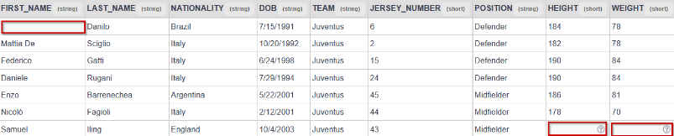
Issues
Data cleaning players table in Dataset 1:
Height and Weight missing values
Foot values missing
First name missing
Team name missing
Jersey number missing
Date of Birth in common format
Remove players over 45 years old
Remove positions that are not GOALKEEPER, DEFENDER, MIDFIELDER and FORWARD

Slide 5
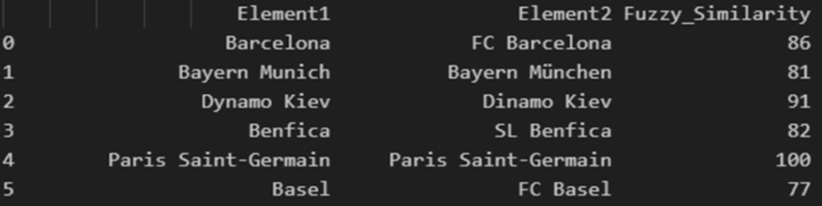
Solutions to solve Issues
Entity Resolution Issues:
Obtain 2 lists with all unique names (one each dataset)
Use fuzzywuzzy’s fuzz library to get similarity scores between names.

Slide 6
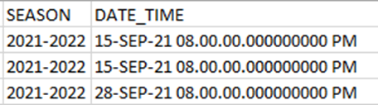
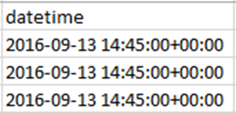
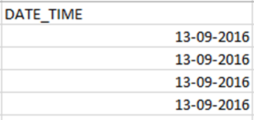
Solutions to solve Issues
Schema Matching Issues:
Dataset 1 contains 2 columns that represent the same as one column in Dataset 2.

Slide 7

Data Cleaning Issues
Height and Weight missing values:
Compute the average of all the players and assign it to empty values.
Insert the “avg_height” values to the 223 empty cells.
Insert the “avg_weight” values to the 394 empty cells.

Slide 8
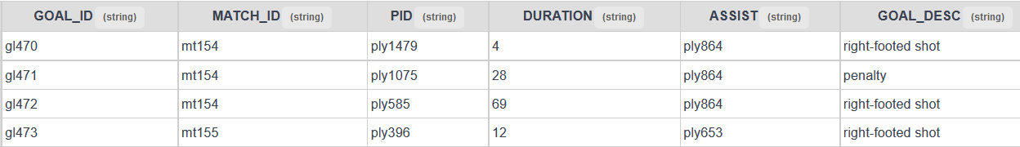
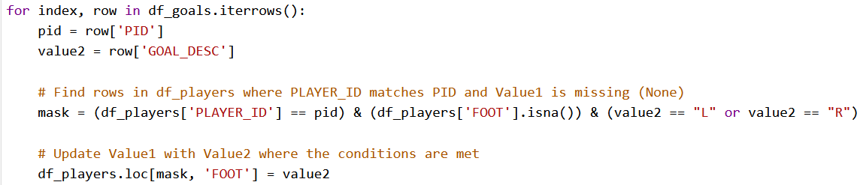
Data Cleaning Issues
449 missing values in the FOOT column of the players table
Having a look at the goals table:
Solves 39/449 missing values.
Assume right foot for the rest of players.
Join on players.PLAYER_ID = goals_ID and determine how the goal was scored (GOAL_DESC attribute).

Slide 9
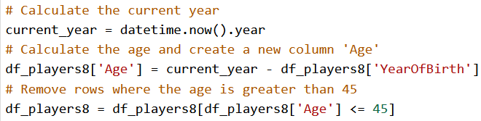
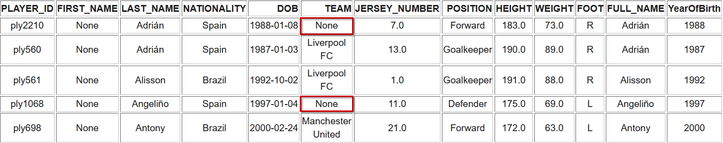
Data Cleaning Issues
DOB values in table players:
Get just the year in which they were born → YearOfBirth column.
Remove players above 45 years old (77 players/rows).

Slide 10
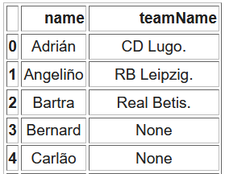
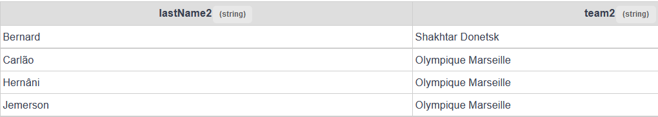
Data Cleaning Issues
TEAM missing values:
439 missing values in the TEAM column of the players table. → Dataset through Webscrapping.
dataset:
Merge results into players table.

Slide 11
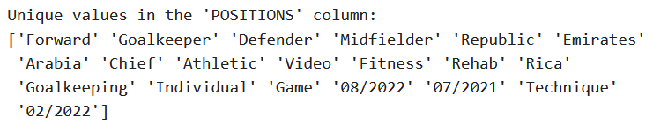
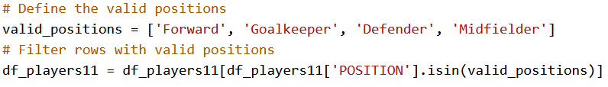
Data Cleaning Issues
POSITION invalid values:
Filter so that we only have: 'Forward', 'Goalkeeper', 'Defender', 'Midfielder'.

Slide 12
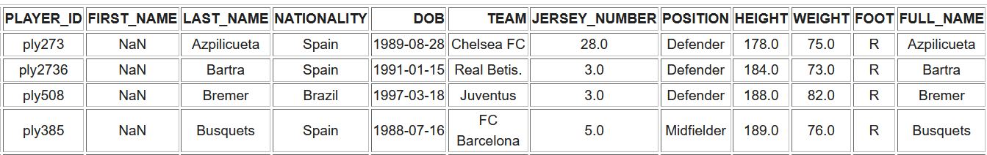
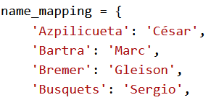
Data Cleaning Issues
FIRST_NAME 166 missing values:
After webscraping → 19 missing values.
Created a mapping and merged it into our final table:

Slide 13
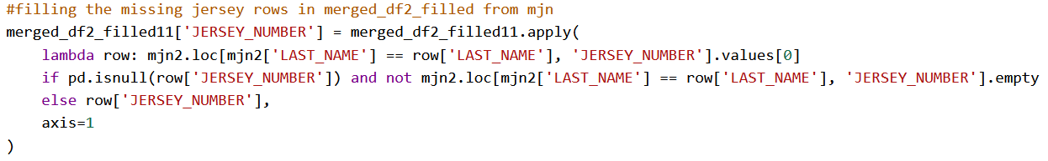
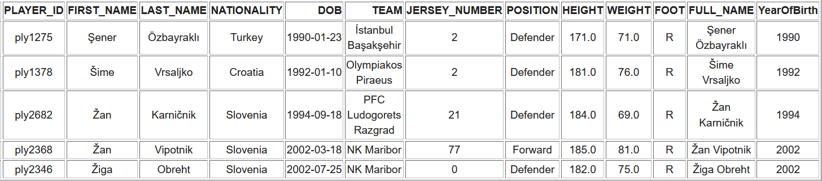
Data Cleaning Issues
JERSEY_NUMBER: 133 missing values and format in float64:
Looked up values on the Internet and fixed 42.

Slide 14
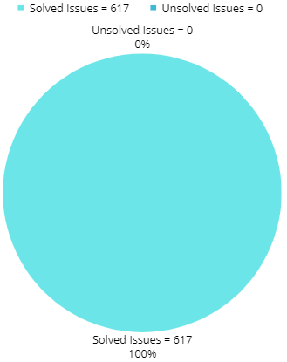
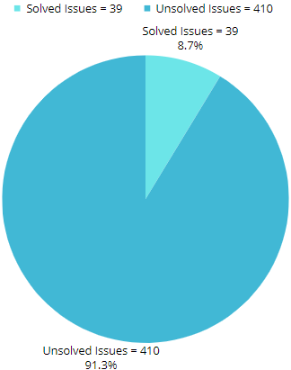
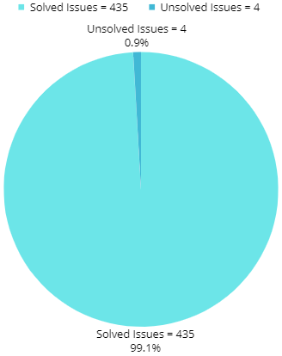
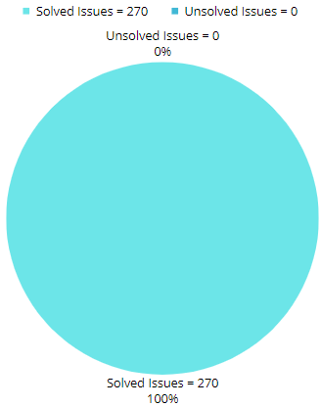
Issues summary
Height and Weight Foot TEAM POSITION

Slide 15
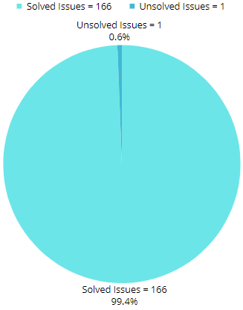
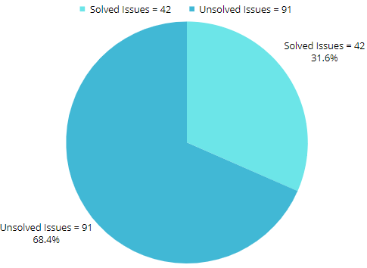
Issues summary
First name Jersey number

Slide 16
Thank you
Any questions?

